Slide 1

AI-Powered University Planner Agent
Streamlining the Master's Application Journey for Every Student

Slide 2
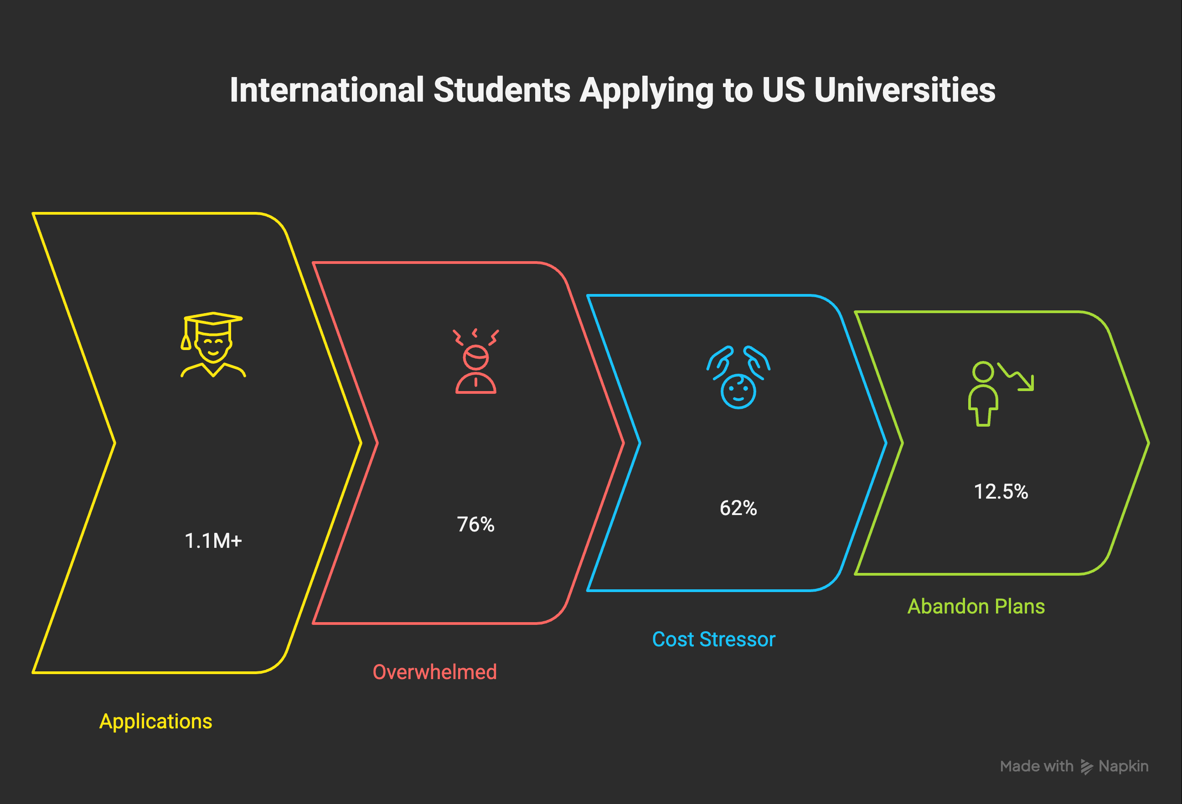
The Problem: Application Stress
1.1M+ International Students Apply to US universities annually.
76% Feel Overwhelmed by the application complexity.
62% Name Cost as Their Biggest Stressor.
12.5% Abandon Plans due to application stress (1 in 8).

Slide 3
Core Problems in University Planning
Information Overload: Scattered data, unreliable sources.
Manual Comparison: Time-consuming, easily missed details.
Generic Advice: Doesn't fit individual goals/budgets/careers.
Deadline Chaos: Missed dates cause overwhelming stress.
Financial Blindness: Unclear costs, missed aid opportunities.
Decision Difficulty: Choosing from thousands of programs is hard.

Slide 4
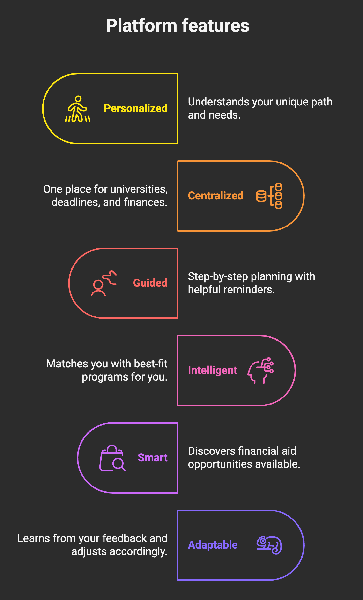
Our AI Solution
Understands your unique path.
One place for universities, deadlines, finances.
Step-by-step planning with reminders.
Matches you with best-fit programs.
Discovers financial aid opportunities.
Learns from your feedback.

Slide 5
How It Works
User Input: Tell us your goals & constraints.
Analysis: Our AI analyzes your profile & global data.
Matching: Compares thousands of programs, courses, deadlines, costs.
Output: Personalized recommendations, planning steps, financial insights.
Learning: We get better based on your feedback.

Slide 6
Tech Stack
Frontend - Streamlit
Backend - FastAPI
AI Agents - Langchain and Langraph
Infrastructure - AWS
Deployment - AWS CLI

Slide 7
Expected Benefits
90% Less Time: Hours of planning reduced!
Better Fits: Higher chance of choosing the right program/university.
Admission Success: Never miss a deadline.
More Financial Aid: Maximize savings and value.
Less Stress: Navigate applications with ease.

Slide 8
References
Institute of International Education (IIE), 2024-2025 United States Hosts More Than 1.1 Million International Students," January 2025 IIE Open Doors Report - International Student Statistics 2023/2024
PrepScholar - "Why Are College Applications So Stressful? 5 Helpful Strategies,” 2024

Slide 9
Thank You
Prasheetha – Worked on the Architecture
Jithin – Worked on Presentation and Data Sources

